Slide 1
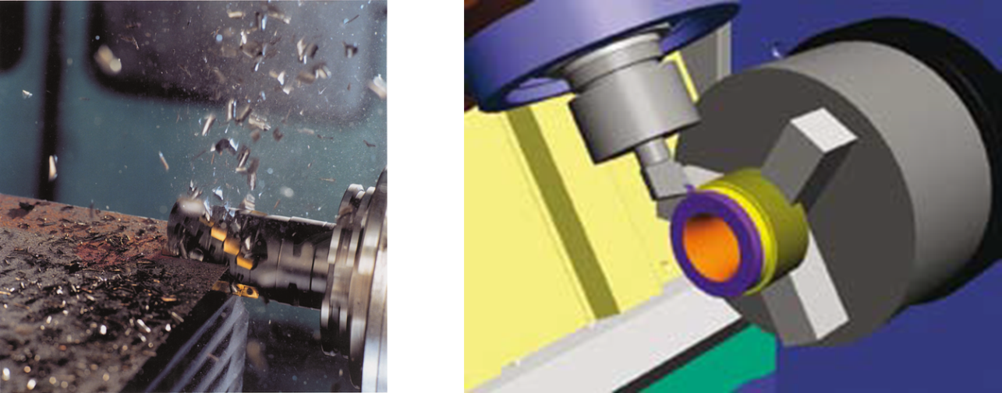
CIMSOURCE erweckt die Digitale Fabrik zum Leben.
CIMSOURCE Digital Tool Services –
Digital twins of cutting tools for the future of manufacturing
Notes:
The road to Industrie 4.0 will lead into “thin air” without the data of the manufacturing resources. To be able to provide and to handle this data will be crucial in the future. CIMSOURCE services will fill that gap.
Press Preview
June 21st 2017
Booth 10 (press preview)
Hall 5 B 48 (EMO show)
Götz Marczinski, CEO
CIMSOURCE GmbH
Kasernenstr. 22
D-52064 Aachen
Tel.: +49 241 8887 713
email: mc@cimsource.com www.cimsource.com

Slide 2
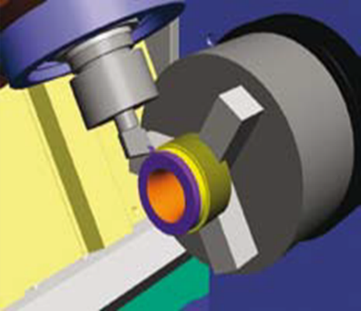
ToolsUnited - The Machining Google
ToolsUnited leads the end user to the right tool and supplies the digital twin.
Supply of Digital Twins
CIMSOURE at EMO?
Search & Retrieval
Notes:
If you face a machining challenge, ToolsUnited will lead you to the right tool.
With a database full of cutting tools it is very likely that the appropriate tool will be retrieved.
Ever more often tool users need a digital representation of the tool. They use it for
NC-verification,
virtual machining or simply to
digitize the supply chain.
To provide the data is a well established feature of ToolsUnited. Be it in standard formats, be it in proprietary formats (CAM-systems, Toolmanagement applications), ToolsUnited is the single source for the Digital Factory.
But what is new at EMO 2017?

Slide 3
ToolsUnited „Where –to- Buy“
35% „only“ of ToolsUnited users look for the digital twin!
Notes:
CIMSOURCE monitors the traffic at ToolsUnited permanently.
As expected the users come from the developed countries. But so far only 30% go for the digital twin.
In contrast, more than 70% of the searches expect to find a source to buy the respective tool. This feature was not available at ToolsUnited, because ToolsUnited is not a sales platform.
However, there are enough webshops out there. Local distributors, the manufacturers‘ web shops, nationwide or even multinational webshops like amazon supply.
Why not lead the customer to these „where-to-buy“ places?
Every tool supplier wants to sell, after all.

Slide 4
ToolsUnited - The Machining Google
ToolsUnited leads the end user to the right tool and guides to the local supplier.
Supply of Digital Twins
Search & Retrieval
Notes:
How does “Where-to-Buy” work?
The ToolsUnited user would search for tools as before. Either using the full text search, the parametric search or the search by application. Whichever method is applied, ToolsUnited will return a list of tools that match the search criteria.
By selecting a tool item from this list, the ToolsUnited user starts the newly developed ToolsUnited crawler that now searches the web for sources to buy this tool.
The list of distributors is displayed, including price information as available in the respective shop. A geo tag makes sure that you find those distributors near by.
If the ToolsUnited user clicks on any of those distributors, ToolsUnited guides the user directly to the results page of the respective shop. The purchase transaction is carried out in the shop of the distributor.
“Where-to-Buy” meets the customers’ expectations. They find what they expect.
“Where-to-Buy” supports local distributors.
“Where-to-Buy” helps to sell.
“Where-to-Buy” is the key to adapt the business model of ToolsUnited according to country specific behavior. This option is currently tested in the US-market.

Slide 5
100% Tool.Data.Digital
3S and ToolLink establish the direct information supply chain from the tool supplier to the tool user.
Supply Side
Demand Side
SalesSupport
Server
ToolLink
myToolsUnited
ToolsUnited
Notes:
ToolsUnited is getting better day by day. But will it ever be perfect?
Pitfalls include:
Not all tool manufacturers are represented.
Sometime some product lines are missing.
Sometimes the data quality is poor.
And: There are specials! Not every tool is a catalogue item.
From the tool suppliers perspective:
Why, if a customer asks for data, should I point him to another web-site?
How, if a customer asks for direct contact, could I establish the appropriate information supply chain?
CIMSOURCE reacts to that issues. The ToolsUnited-technology is made available for proprietary use.
Tool suppliers may opt for the “SalesSupportServer”. This is basically a “myToolsUnited” with sophisticated data management and -mapping features.
Tool user may operate a ToolLink-portal. ToolLink helps to define the data demand unambiguously, establishes and monitors the communication to the suppliers. And ToolLink has ToolsUnited inside.
3S and ToolLink push the ToolsUnited-platform to the background. Toolsuppliers and tool users communicate directly.

Slide 6
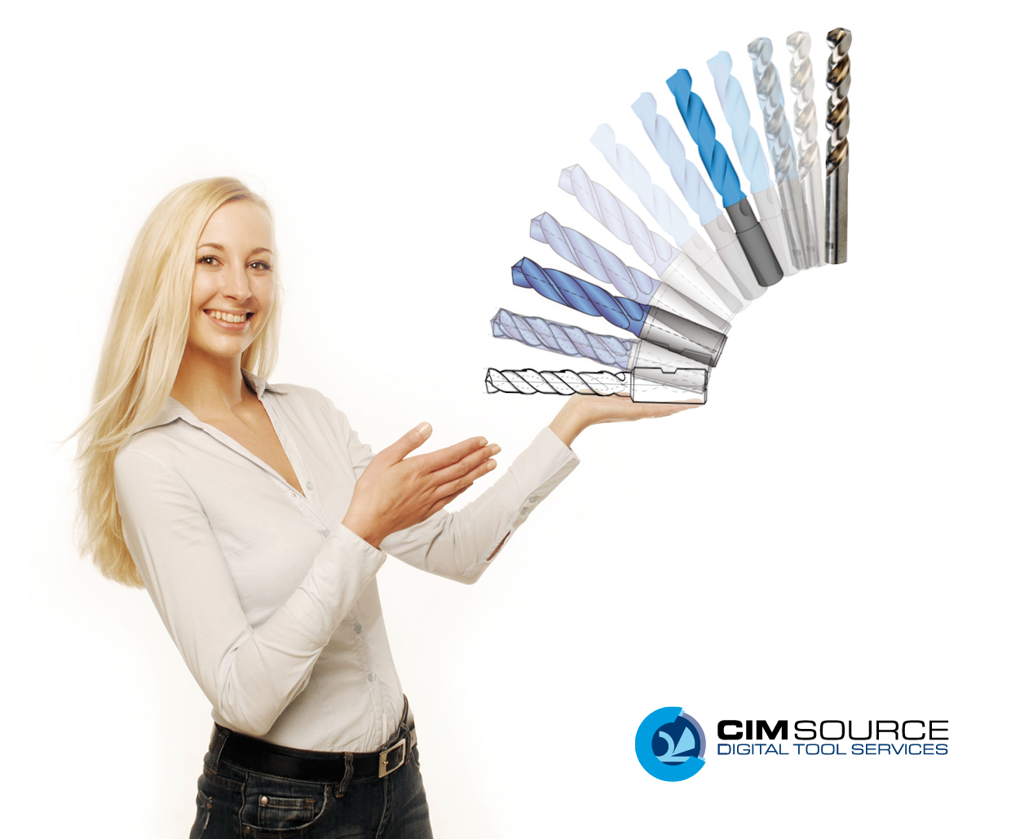
Tool.Data.Digital!
Meet us at EMO!
Hall 5 B48
Besuchen Sie uns!
Contact:
CIMSOURCE GmbH
Julia Eisenberg
Kasernenstr. 22
D-52064 Aachen
Tel.: +49 241 8887 713
email: eis@cimsource.com

